Slide 1


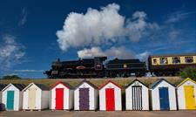
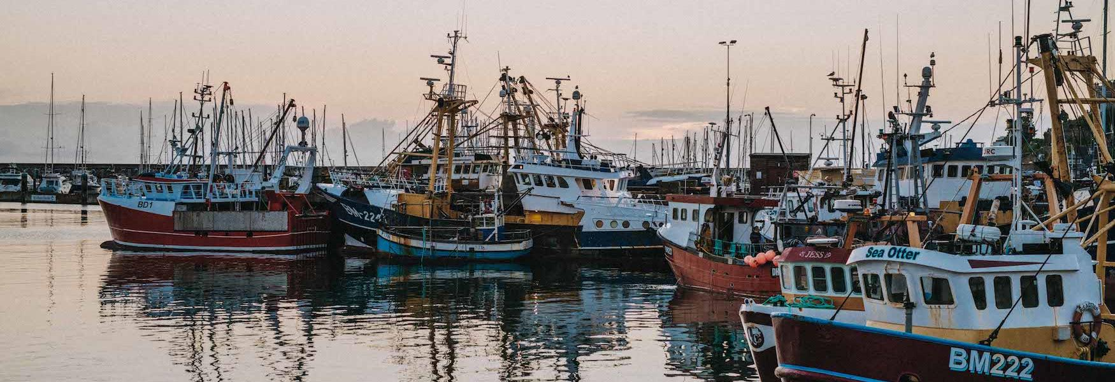
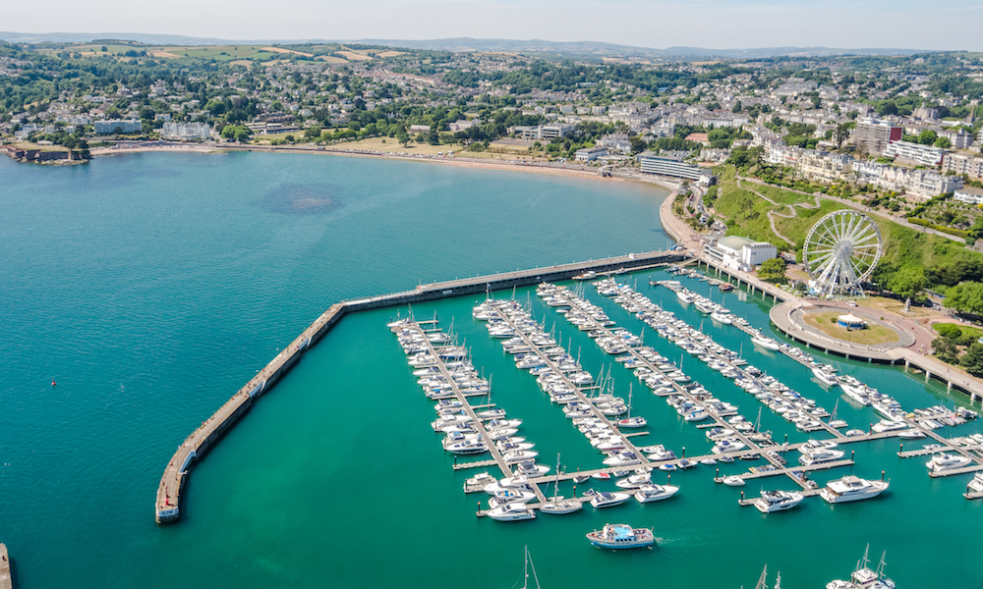

The Economic Impact of the Torbay Visitor Economy 2024
Produced on behalf of the English Riviera BID Company
By
The South West Research Company Ltd
October 2025

Slide 2
Contents
Page
Introduction 3
Torbay data 4
Devon data 14

Slide 3
Introduction
This report examines the volume and value of tourism and the impact of visitor expenditure on the local economy in Torbay and Devon county and districts in 2024 (it should be noted that only those districts participating in the project are displayed).
The figures were derived using the Cambridge Economic Impact Model undertaken by The South West Research Company (TSWRC). The model utilises information from national tourism surveys and regionally/locally based data. It distributes regional activity as measured in those surveys to local areas using ‘drivers’ such as the accommodation stock and occupancy which influence the distribution of tourism activity at local level.
For further information on the Cambridge Model and the terms used in this report please see Appendix 1 which accompanies this report.
For an overview of 2024, including key facts about the economy, weather and key events please see Appendix 2 of this report.

Slide 4
Value of Tourism 2024
Torbay
Key Facts
833,000 | Staying visitor trips
3,624,200 | Staying visitor nights
£277,793,000 | Staying visitor spend
2,704,000 | Day visits
£137,943,000 | Day visitor spend
£415,736,000 | Direct visitor spend
£13,038,585 | Other related spend
£428,774,585 | TOTAL VISITOR RELATED SPEND
7,589 | Estimated actual employment
5,624 | FTE employment
12% | Proportion of all employment

Slide 5
Torbay - Staying visits in the county context
Area | Domestic trips (000’s) | Overseas trips (000’s) | Domestic nights (000’s) | Overseas nights (000’s) | Domestic spend (millions) | Overseas spend (millions)
East Devon | 561 | 42 | 2,648 | 364 | £155 | £24
Exeter | 306 | 46 | 1,051 | 618 | £68 | £43
Mid-Devon | 209 | 20 | 884 | 154 | £52 | £10
North Devon | 691 | 50 | 3,380 | 359 | £206 | £27
Plymouth | 500 | 67 | 1,756 | 728 | £103 | £48
South Hams | 351 | 31 | 1,687 | 276 | £102 | £19
Torbay | 754 | 79 | 3,077 | 547 | £231 | £47
Torridge | 183 | 18 | 787 | 145 | £47 | £9
West Devon | 181 | 20 | 695 | 151 | £46 | £11

Slide 6
Torbay - Staying visits by accommodation type
Domestic tourists | Trips | Nights | Spend
Serviced | 369,000 | 1,195,000 | £126,986,000
Self catering | 71,000 | 450,000 | £36,226,000
Touring caravans /tents | 29,000 | 163,000 | £7,196,000
Static vans/holiday centres | 113,000 | 660,000 | £38,011,000
Group/campus | 1,000 | 2,000 | £141,000
Paying guest in private homes | 0 | 0 | £0
Second homes | 13,000 | 65,000 | £2,115,000
Boat moorings | 7,000 | 31,000 | £1,764,000
Other | 6,000 | 10,000 | £507,000
Staying with friends and relatives | 147,000 | 500,000 | £17,871,000
Total | 754,000 | 3,077,000 | £230,816,000
Overseas tourists | Trips | Nights | Spend
Serviced | 47,900 | 201,900 | £27,148,000
Self catering | 4,500 | 50,900 | £4,165,000
Touring caravans /tents | 1,500 | 8,400 | £513,000
Static vans/holiday centres | 900 | 6,500 | £504,000
Group/campus | 200 | 6,100 | £447,000
Paying guest in private homes | 2,900 | 82,100 | £5,151,000
Second homes | 700 | 9,400 | £516,000
Boat moorings | 0 | 0 | £0
Other | 1,600 | 4,500 | £138,000
Staying with friends and relatives | 18,800 | 177,500 | £8,396,000
Total | 79,000 | 547,200 | £46,977,000

Slide 7
Torbay - Day visits in the county context
Area | Day visits (mn) | Day visit spend (£mn)
East Devon | 3.1 | £144.4
Exeter | 1.5 | £82.6
Mid-Devon | 1.3 | £57.4
North Devon | 2.3 | £107.7
Plymouth | 3.6 | £194.8
South Hams | 2.9 | £130.6
Torbay | 2.7 | £137.9
Torridge | 1.4 | £62.3
West Devon | 1.3 | £55.4

Slide 8
Torbay - Day visits by location
Total day visits | Total day visit spend
2,704,000 | £137,943,000

Slide 9
Torbay - Direct visitor expenditure by category
Information on the breakdown of visitor spending is available from the three main tourism and day visitor surveys by type of visitor. The Model divides the expenditure between five sectors:
  Accommodation
  Shopping for gifts, clothes and other goods
  Eating and drinking in restaurants, cafes and inns
  Entry to attractions, entertainment and hire of goods and services
  Transport and travel costs including public transport, purchase of fuel and parking
The following pages look at the breakdown of this expenditure and business turnover arising from this expenditure.
By applying the expenditure breakdown to the estimates of visitor spending the Model generates estimates of total spending by the five business sectors. Visitor expenditure in each sector represents additional turnover for businesses in those sectors. However, evidence from national studies suggests that some minor adjustments are required to match visitor spend to business turnover. In particular, some expenditure on food and drink actually takes place in inns and hotels that fall into the accommodation sector and at attractions. The turnover for each business sector has therefore been adjusted to take account of these marginal changes. More significantly, expenditure on travel costs associated with individual trips is as likely to take place at the origin of the trip as it is at the actual destination. It is therefore assumed that only 60% of total travel expenditure accrues to the destination area.
6

Slide 10
Torbay – Direct visitor expenditure by category
Accommodation
UK staying visitors £85,425,000
Overseas staying visitors £12,089,000
Shopping
UK staying visitors £33,061,000
Overseas staying visitors £14,790,000
Food & drink
UK staying visitors £46,104,000
Overseas staying visitors £10,184,000
Attractions/entertainment
UK staying visitors £21,558,000
Overseas staying visitors £4,920,000
Travel
UK staying visitors £44,668,000
Overseas staying visitors £4,994,000
Day visitors £44,512,000
Day visitors £54,369,000
Day visitors £13,159,000
Day visitors £25,902,000
Totals
£97,514,000 (23%)
£92,363,000 (22%)
£110,657,000 (27%)
£39,637,000 (10%)
£75,564,000 (18%)
6

Slide 11
Torbay – Other visitor related expenditure by category
Second Homes
£1,212,000
Boats
£2,785,000
Visiting friends and relatives (non-visitor spend)
£9,042,000
Spend on second homes estimates cover rates, maintenance, and replacement of furniture and fittings.
Spend on boats estimates cover berthing charges, servicing and maintenance and upgrading of equipment.
Additional spending is incurred by friends and relatives as a result of people coming to stay with them.
6

Slide 12
Torbay – Tourism related employment
Having identified the value of turnover generated by visitor spending in each business sector it is possible to estimate the employment associated with that spending.
The use of visitor expenditure to generate job numbers underestimates the number of jobs arising in the attractions/entertainment sector. The underestimate arises because local authorities and voluntary bodies do not always seek to recoup the full operating costs of individual attractions of facilities from entrance charges. Therefore an additional percentage of direct employment is added to the attractions sector estimates to take account of this factor.
This section of the report looks at employment on three levels;
  Direct Jobs - Direct jobs are those in businesses in receipt of visitor spending. For example, jobs supported by visitor spending at a hotel would be direct jobs.
  Indirect Jobs - Indirect employment arises as a result of expenditure by businesses in direct receipt of visitor expenditure on the purchase of goods and services for their businesses. For example, some of the employment at a business supplying food and drink may be supported through the supplies that the business sells to hotels (or any other business in direct receipt of visitor expenditure).
  Induced Jobs - Induced jobs are those that are supported by the spending of wages by employees in direct and indirect jobs. Such spending will be spread across a wide range of service sectors.
Estimates are shown for actual jobs and full time equivalent jobs (FTE’s).
6

Slide 13
Torbay – Tourism related employment
Estimated actual employment
Direct
5,409
Indirect
1,597
Induced
583
Total
7,589
Full time equivalent employment (FTE’s)
Direct
3,712
Indirect
1,401
Induced
511
Total
5,624
Direct employment in businesses in receipt of visitor expenditure (FTE’s) | Staying visitor related | Day visitor related | Total
Accommodation | 1,061 | 12 | 1,073
Retailing | 320 | 298 | 618
Catering | 516 | 498 | 1,014
Attractions/entertainment | 392 | 201 | 593
Transport | 159 | 83 | 241
Arising from non trip spend | 173 | 0 | 173
Total Direct | 2,620 | 1,092 | 3,712
6

Slide 14


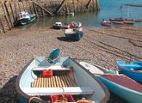


Devon 2024

Slide 15
Devon - Key facts at a glance
Total staying trips
UK 4,129,000
Overseas 407,000
Total visitor nights
UK 17,749,000
Overseas 3,599,000
Total visitor spend
Overseas £254,002,000
UK £1,107,969,000
Total staying and day trips
27,050,000
Total day trips
22,514,000
Total day trip spend
£1,101,310,000
Total visitor related spend
£2,562,303,000
Friends and relatives spend (non-visitor)
£79,909,000
Direct employment
30,185
Indirect employment
10,178
Induced employment
6,776
Total estimated actual employment
47,138
(35,661 FTEs)
8%
of all employment
Second home/holiday accommodation spend
£19,113,000

Slide 16
Devon - Staying visits by accommodation type
Domestic tourists | Trips | Nights | Spend
Serviced | 1,067,000 | 3,459,000 | £367,490,000
Self catering | 409,000 | 2,587,000 | £208,277,000
Touring caravans /tents | 430,000 | 2,431,000 | £107,138,000
Static vans/holiday centres | 674,000 | 3,937,000 | £226,606,000
Group/campus | 82,000 | 227,000 | £13,731,000
Paying guest in private homes | 0 | 0 | £0
Second homes | 99,000 | 490,000 | £16,022,000
Boat moorings | 24,000 | 112,000 | £6,294,000
Other | 49,000 | 86,000 | £4,477,000
Staying with friends and relatives | 1,295,000 | 4,421,000 | £157,934,000
Total | 4,129,000 | 17,749,000 | £1,107,969,000
Overseas tourists | Trips | Nights | Spend
Serviced | 139,000 | 584,000 | £78,563,000
Self catering | 26,000 | 293,000 | £23,947,000
Touring caravans /tents | 23,000 | 125,000 | £7,644,000
Static vans/holiday centres | 6,000 | 40,000 | £3,135,000
Group/campus | 19,000 | 594,000 | £43,648,000
Paying guest in private homes | 10,000 | 283,000 | £17,743,000
Second homes | 5,000 | 71,000 | £3,906,000
Boat moorings | 0 | 0 | £0
Other | 14,000 | 40,000 | £1,217,000
Staying with friends and relatives | 166,000 | 1,568,000 | £74,199,000
Total | 407,000 | 3,599,000 | £254,002,000

Slide 17
Devon - Estimated seasonality of staying visits
6

Slide 18
Devon - Estimated seasonality of staying visits
6

Slide 19
Devon - Day visits by location
Total day visits | Total day visit spend
22,514,000 | £1,101,310,000

Slide 20
Devon - Estimated seasonality of day visits
6

Slide 21
Devon – Direct visitor expenditure by category
Accommodation
UK staying visitors £410,058,000
Overseas staying visitors £65,362,000
Shopping
UK staying visitors £158,702,000
Overseas staying visitors £79,966,000
Food & drink
UK staying visitors £221,309,000
Overseas staying visitors £55,066,000
Attractions/entertainment
UK staying visitors £103,482,000
Overseas staying visitors £26,604,000
Travel
UK staying visitors £214,419,000
Overseas staying visitors £27,004,000
Day visitors £372,222,000
Day visitors £425,194,000
Day visitors £118,473,000
Day visitors £185,422,000
Totals
£475,420,000 (19%)
£610,890,000 (25%)
£701,569,000 (28%)
£248,559,000 (10%)
£426,845,000 (17%)
6

Slide 22
Devon – Other visitor related expenditure by category
Second Homes
£9,177,000
Boats
£9,936,000
Visiting friends and relatives (non-visitor spend)
£79,909,000
6

Slide 23
Devon – Business turnover
Turnover derived from trip expenditure | Staying visitor related | Day visitor related | Total
Accommodation | £480,948,000 | £8,504,000 | £489,452,000
Retailing | £236,281,000 | £368,500,000 | £604,781,000
Catering | £268,083,000 | £412,438,000 | £680,521,000
Attractions/entertainment | £135,236,000 | £126,447,000 | £261,683,000
Transport | £144,854,000 | £111,253,000 | £256,107,000
Arising from non trip spend | £99,021,501 | £0 | £99,021,501
Total Direct | £1,364,423,501 | £1,027,142,000 | £2,391,565,501
Total business turnover supported by tourism activity | Staying visitor related | Day visitor related | Total
Direct | £1,364,423,501 | £1,027,142,000 | £2,391,565,501
Supplier and income induced | £704,993,000 | £413,797,000 | £1,118,790,000
Total | £2,069,416,501 | £1,440,939,000 | £3,510,355,501
6

Slide 24
Devon – Tourism related employment
Estimated actual employment
Direct
30,185
Indirect
10,178
Induced
6,776
Total
47,138
Full time equivalent employment (FTE’s)
Direct
20,789
Indirect
8,928
Induced
5,943
Total
35,661
Direct employment in businesses in receipt of visitor expenditure (FTE’s) | Staying visitor related | Day visitor related | Total
Accommodation | 4,828 | 85 | 4,914
Retailing | 1,489 | 2,323 | 3,812
Catering | 2,364 | 3,637 | 6,001
Attractions/entertainment | 1,796 | 1,679 | 3,475
Transport | 719 | 552 | 1,271
Arising from non trip spend | 1,316 | 0 | 1,316
Total Direct | 12,513 | 8,277 | 20,789
6

